Slide 1
Summary of three events:
1. May 28-29, 2010
2. Feb 2-3, 2016
3. May 28-29, 2013
MURI telecon @06/15/2020

Slide 2
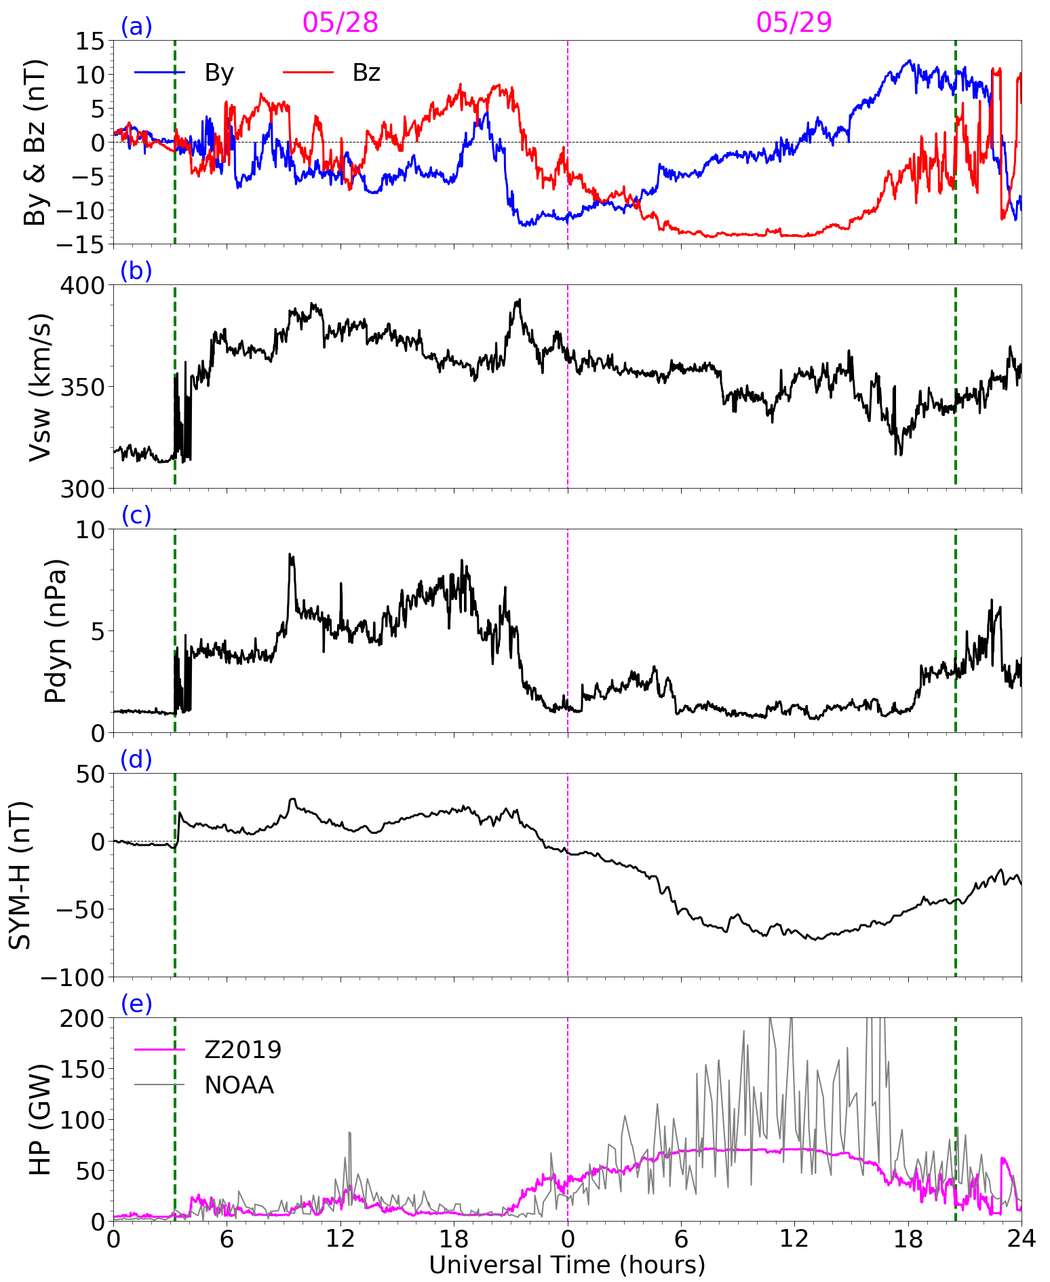
1. May 28-29, 2010 storm
Overview:
Shock arrived ~ 3 UT, 05/28/2010
Magnetic cloud arrived ~ 21 UT, 05/28/2010, and last ~24 hours
Shock
min SYM-H: -74 nT
Comparison of HP provided by NOAA and estimated by Z2019:
Magnetic Cloud
NOAA: Data + model (1987-2013)
Z2019: model
Z2019 HP showed similar trend with the NOAA HP, but was ~40% smaller
[Zhu et al., 2020, submitted]

Slide 3
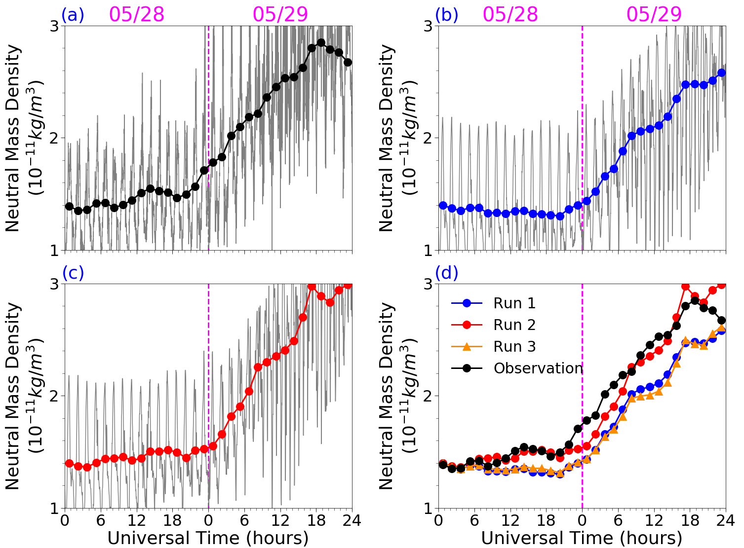
Neutral mass densities from GOCE and GITM simulations
GOCE satellite
Sun-synchronous orbits, 90 min
230~280 km, dawn-dusk
Data is mapped to 270 km according to the MSIS
GITM simulations
Run 1: GITM (FRE87 Maxwellian spectra, driven by the NOAA HP)
Run 2: GITM (Z2019 spectra)
Outputs are scaled to obtain the NOAA HP, so that the particle energy inputs between Run 1 and Run 2 are comparable
Neutral mass density was better estimated in Run 2 (10~15%)
[Zhu et al., 2020, submitted]

Slide 4
Courtesy of Astrid Maute

Slide 5
Courtesy of Astrid Maute

Slide 6
2. Feb 2-3, 2016 storm
SuperDARN
ISR
TEC
Patches
Fast
flows
ASI
Courtesy of Toshi Nishimura

Slide 7
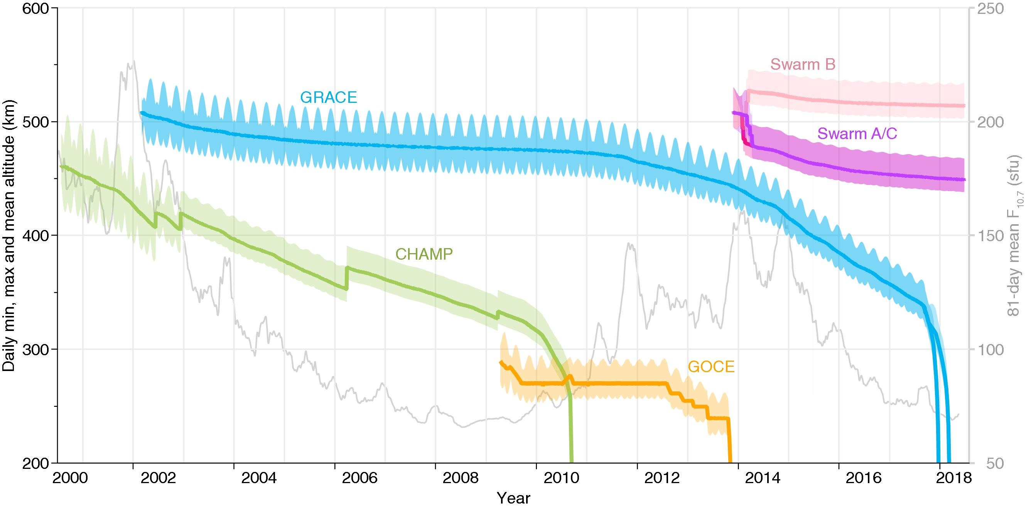
Neutral density & winds:
[March et al, 2019]
Swarm C
Courtesy of Cheng Sheng

Slide 8
Potential researches (from Toshi):
Discussions:
How can we take advantage of the abundant data to improve the forcing specification? Empirical model with global coverage, AMIE, or real data with limited spatial-temporal coverage?
Difference of PCP between SuperDARN large-scale and Weimer
The coverage of ASI imagers for the whole polar region
Regional SuperDARN high-resolution (Cheng)
Impact of variable cusp soft particle precipitation on polar cap patches in the Dayside (Qingyu)
How about Jan 31-Feb 1?
… …

Slide 9
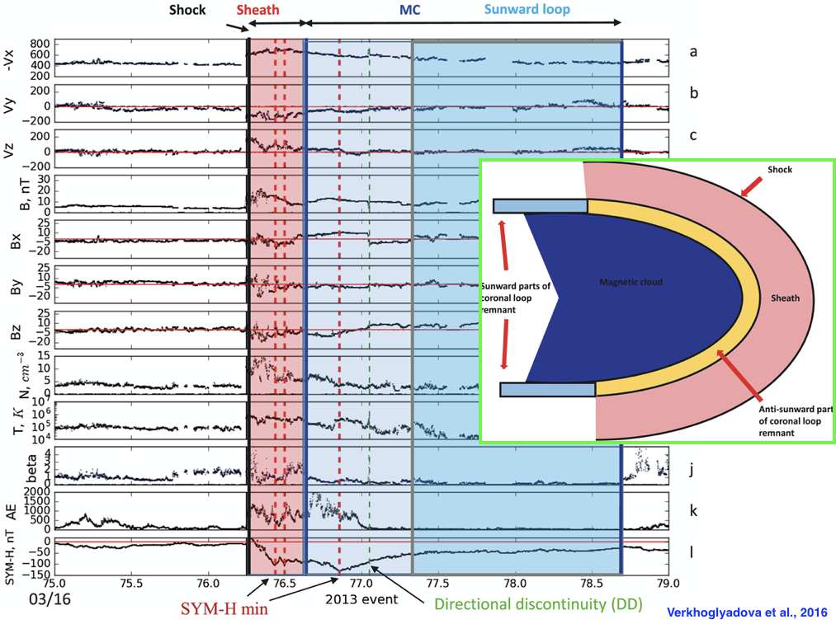
3. March, 17 2013 storm
Shock arrived ~ 06 UT on 03/17/2013
Magnetic cloud arrived ~ 1522 UT on 03/17/2013, and ended ~1648 UT on 03/18/2013 (~25 Hours)
Min SYM-H: -132 nT
Notes:
The geomagnetic storm of 17–20 March 2013 is stronger than the previous one with a minimum SYM-H
of ~132 nT. The interplanetary data and geomagnetic indices are shown in Figure
Simplified schematic of ICME and upstream features detected at 1 AU during the analyzed storm intervals
If the ICME has a speed differential relative to
the upstream plasma greater than the local magnetosonic wave speed a collisionless shock (and sheath) will
form [Tsurutani et al., 1988]
The upstream sheath is
compressed and heated slow solar wind which is present sunward of the ICME shock.

Slide 10
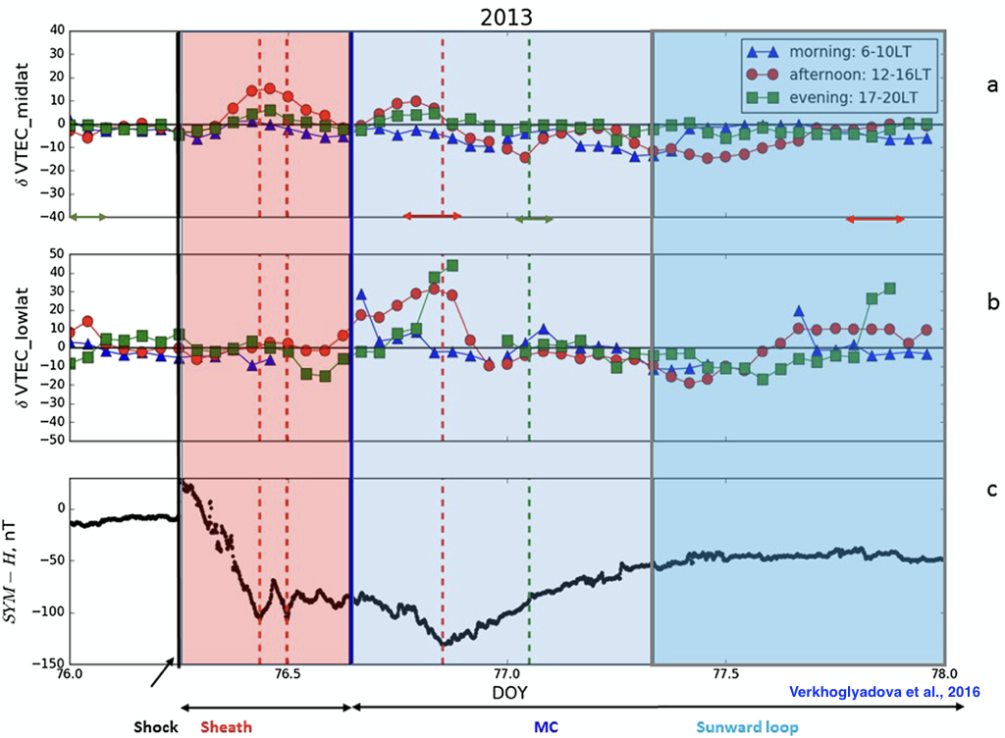
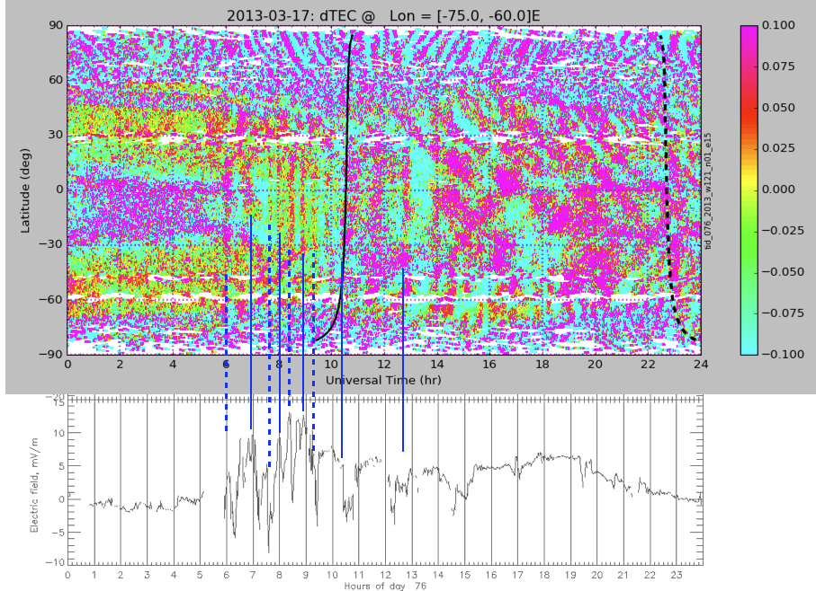
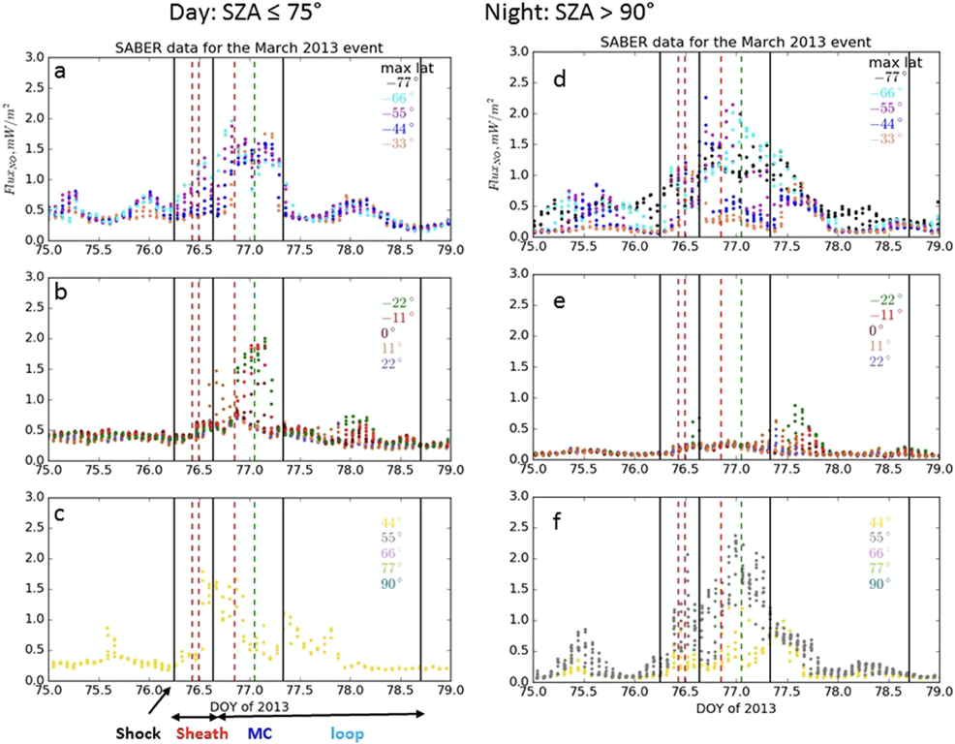
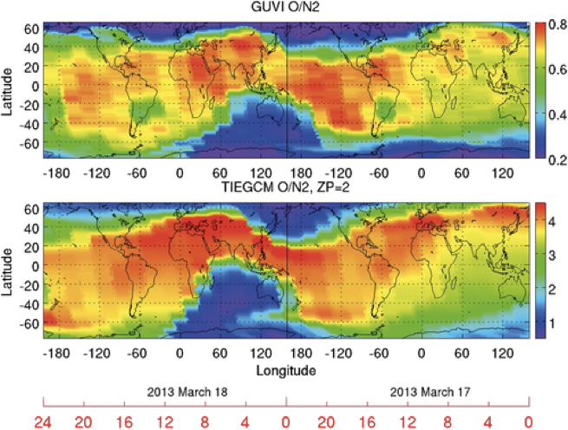
TEC
2000 UT
TEC
Yue et al. (2016)
Liu et al. (2016)
Courtesy of Shunrong Zhang
O/N2
SABER-NO
Data assimilation
~450 GNSS
10 satellite
Yue et al. (2016)
Time
Yue et al. (2016)
Verkhoglyadova et al. (2016)
Notes:
Long-lasting negative ionospheric storm effects in low and middle lattidues,
an ionospheric electron density reanalysis algorithm was used to generate global optimized electron density by assimilating ~10 low Earth orbit satellites based and ~450 ground global. The reanalyzed electron density could identify the large-scale ionospheric features quite well during storm time, including the storm-enhanced density, the positive ionospheric storm effect during the initial and main phases, and the negative ionospheric storm effect during the recovery phase. Inter-hemispheric asymmetry.
Modeling effort with TIEGCM has been conducted to identify the mechanisms for SED and the tongue of ionization (TOI) through term analysis.

Slide 11
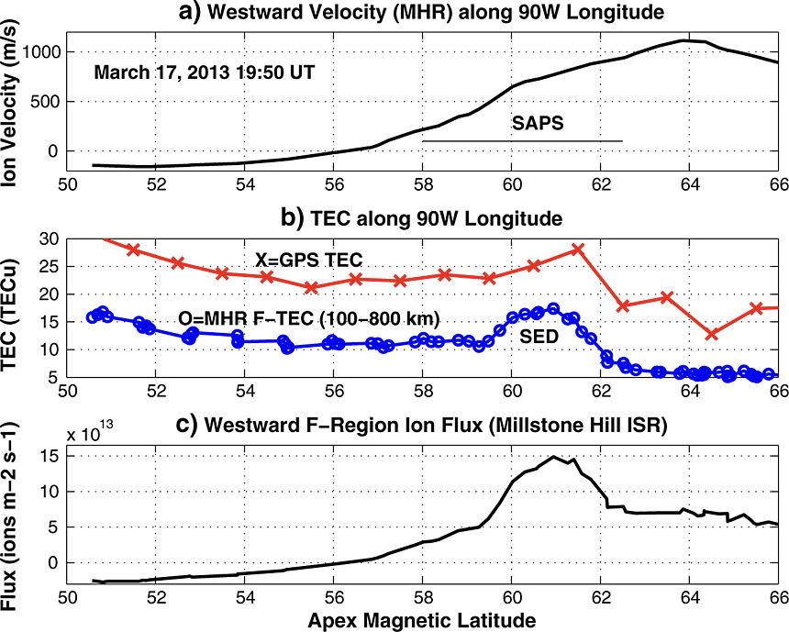
SAPS:
Courtesy of Shunrong Zhang
Potential researches (from Shunrong):
1. SEDs at European sectors and in the southern hemisphere
2. Ionospheric impulsive responses to interplanetary shocks
3. TIDs
4. SAPS and neutral wind dynamics
Ferdousi et al. (2019)
DMSP, GOCE and comparison with RCM-CTIPe simulations
Flywheel effect: R1 FAC 20% and Vi 40%.

Slide 12
P_{dyn} impact
Aurora
Penetrating E
synergizing observations
Aurora, convection, current signatures of disturbances and modes of E
Their relation to:
Ionospheric trough and density structures Plasmapause erosion and ring current injection
2nd S Bz
(0645-0720 UT)
  Oval expands
  equatorward
  Diffuse aurora,
  less streamers
  ~Steady enhanced mid-lat conv.
  Questions (from Larry):
  Why electric field enhancements had three different manifestations?
  Why bursty enhancement interval most effective in driving storm phenomena?
Need coordinated, simultaneous. multi-instrument observations of main phase phenomena for additional storms
After 08 UT
  More streamers
  Bursty, mid-lat E’s
  Oval pushes equatorward
  (DMSP bndries consistent)
  Some bursts extend sub-auroral
Liu et al. (2016)
Lyons et al. (2016)
Substorm onsets over Alaska~0856,~0902.
No other main phase onsets within FOVs
Start of rel. elec energiztions ~14-15 UT [W. Li et al., 2014], just after Pdyn decreases to ~ 5 nPa
Notes:
These three modes were reflected in the aurora and in ionospheric and field-aligned currents: polarward expansion, equatorward expansion and structured bursty flow.

Slide 13
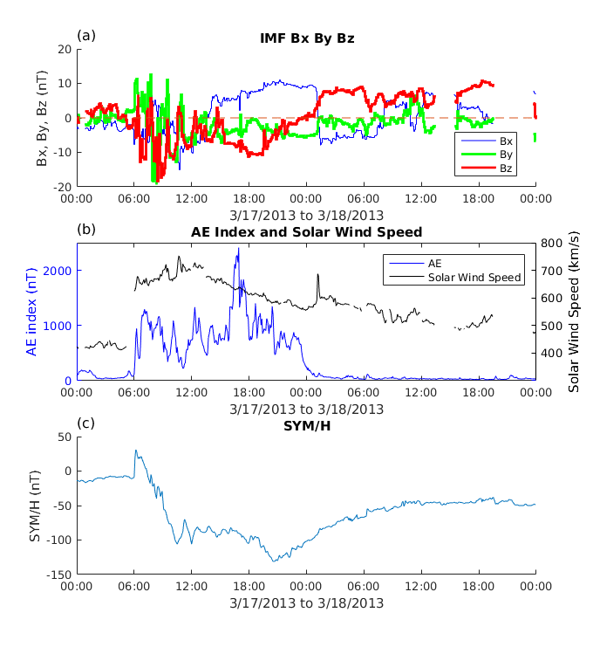
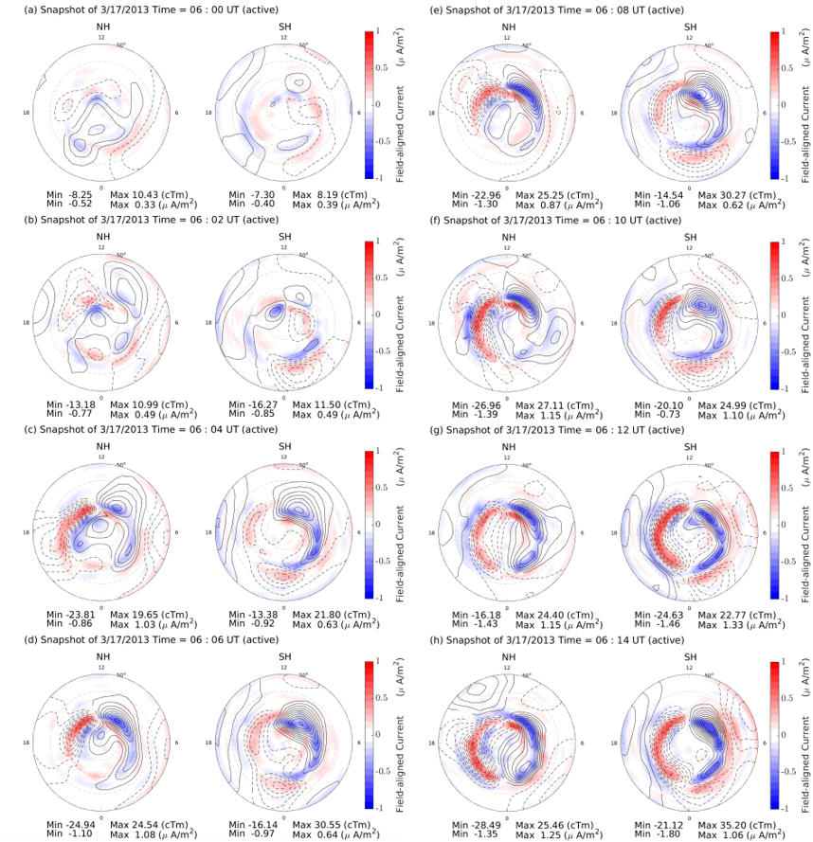
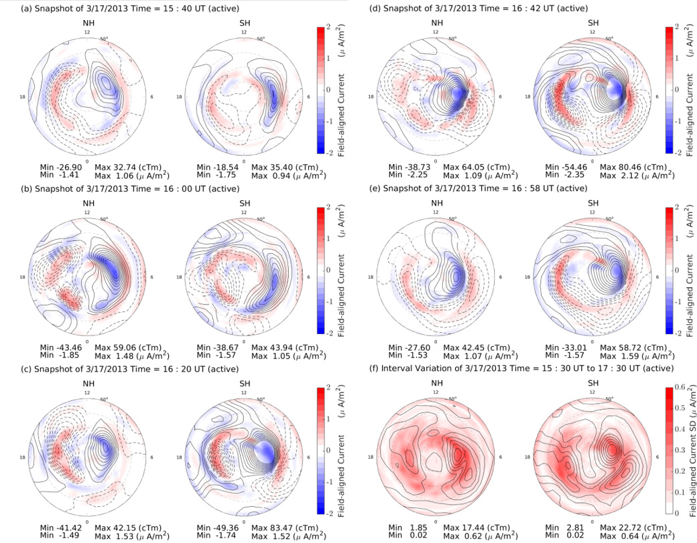
AMPERE FAC EOFs analysis for Rapid change in FAC patterns:
Extreme substorm:
AE ~2650 nT; Dawnside Current Wedge
  Shock arrival: 2 min cadence;
  Follow development across the polar cap
Shi et al. (2020)
Possible Questions (from Delores):
Question: How does the neutral atmosphere respond to this rapid driving?
We map the FAC response to the three intervals of southward IMF during sheath passage and can provide these to GITM (via Astrid’s TIEGCM method (or via other methods that Yue’s grad student has created).
Question: Can GITM respond to this rapid cadence of change?
Question: Do these patterns drive GITM differently than using SuperDARN convection?
The ICME arrived with IMF south field first about 13 UT. The FACs vary more smoothly for several hours prior to development of the super substorm.
Question: Are there detectible differences in GITM with the change in driving
We investigated the specifics the super-substorm (1540-1730 UT). We see different temporal response in the two hemispheres
Question: Does this hemispheric difference matter to the neutral atmosphere?
The IMF turns northward about 01 UT on 18 March. We see numerous instance of short-lived two cell reverse convection
Question: How long does it take for the neutral atmosphere to recover ?
Question: Can the flywheel effect be extracted?

Slide 14
Neutral density & winds:
[March et al, 2019]
GRACE
New results from UTD --- Rod
Courtesy of Cheng Sheng

Slide 15
Questions:
Sheath with lots of transient phenomena, MC with large-scale structures, or recovery phase;
How to improve the specification of dynamical forcing during sheath period;
Empirical model, AMIE or real data;
Machine Learning reconstruct globe TEC map and LSTID;
… …

